Slide 1

Geometry
Unit 12, Lesson 6 Lengths of Secants, Tangents, Segments, and Chords in Circles Volume 2, pg. 257

Slide 2


Benchmark
MA.912.GR.6.1
Solve mathematical and real-world problems involving the length of a secant, tangent, segment, or chord in a given circle.
volume 2, pg. 257

Slide 3
Integrated Mathematical Thinking and Reasoning Standards
MA.K12.MTR.1.1 Actively participate in effortful learning both individually and collectively.
MA.K12.MTR.3.1 Complete tasks with mathematical fluency.
MA.K12.MTR.4.1 Engage in discussions that reflect on the mathematical thinking of self and others.
MA.K12.MTR.5.1 Use patterns and structure to help understand and connect mathematical concepts.
volume 2, pg. 257

Slide 4

Learning Target
I can solve mathematical and real-world problems involving the lengths of secants, tangents, segments, or chords of a circle.
volume 2, pg. 257

Slide 5

Warm-Up
volume 2, pg. 257

Slide 6
12.6.1 Warm-Up: Critical Thinking
Explain how math could be considered a language used for communication.
Suppose you were taking Geometry in another country. How do you think the problems would differ?
volume 2, pg. 257

Slide 7

Activity
volume 2, pg. 258

Slide 8

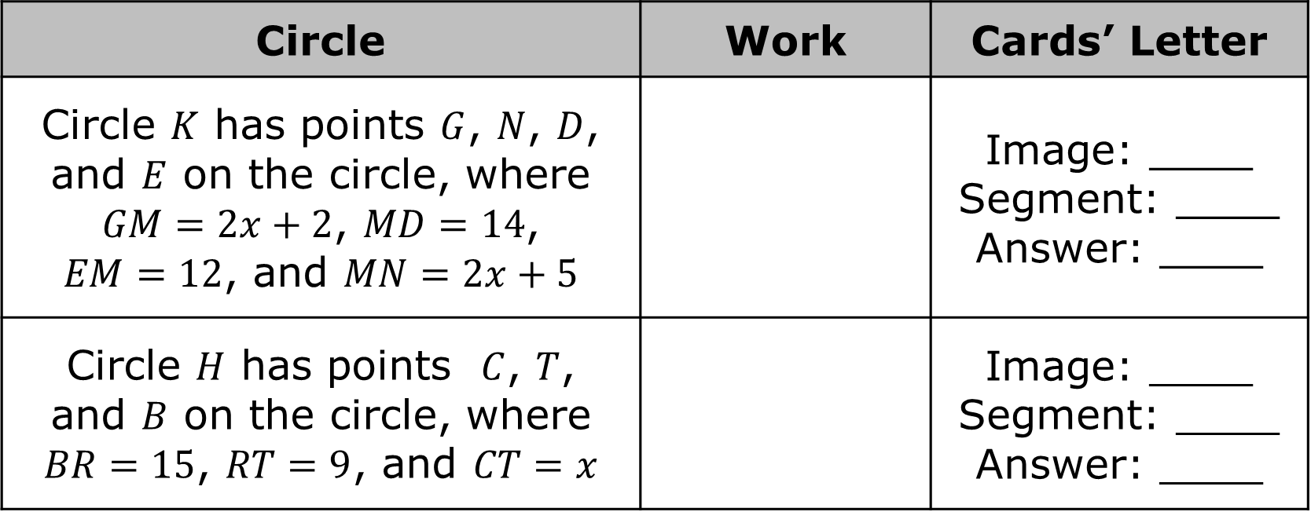
12.6.2 Activity: Line Segments of Circles
Match each image, type of segment, and answer to the description of circles. Record your answers in the table.
Circle | Work | Cards’ Letter
Circle $K$ has points $G$, $N$, $D$, and $E$ on the circle, where $GM=2x+2$, $MD=14$, $EM=12$, and $MN=2x+5$ |  | Image: ____ Segment: ____ Answer: ____
Circle $H$ has points $C$, $T$, and $B$ on the circle, where $BR=15$, $RT=9$, and $CT=x$ |  | Image: ____ Segment: ____ Answer: ____
volume 2, pg. 258

Slide 9
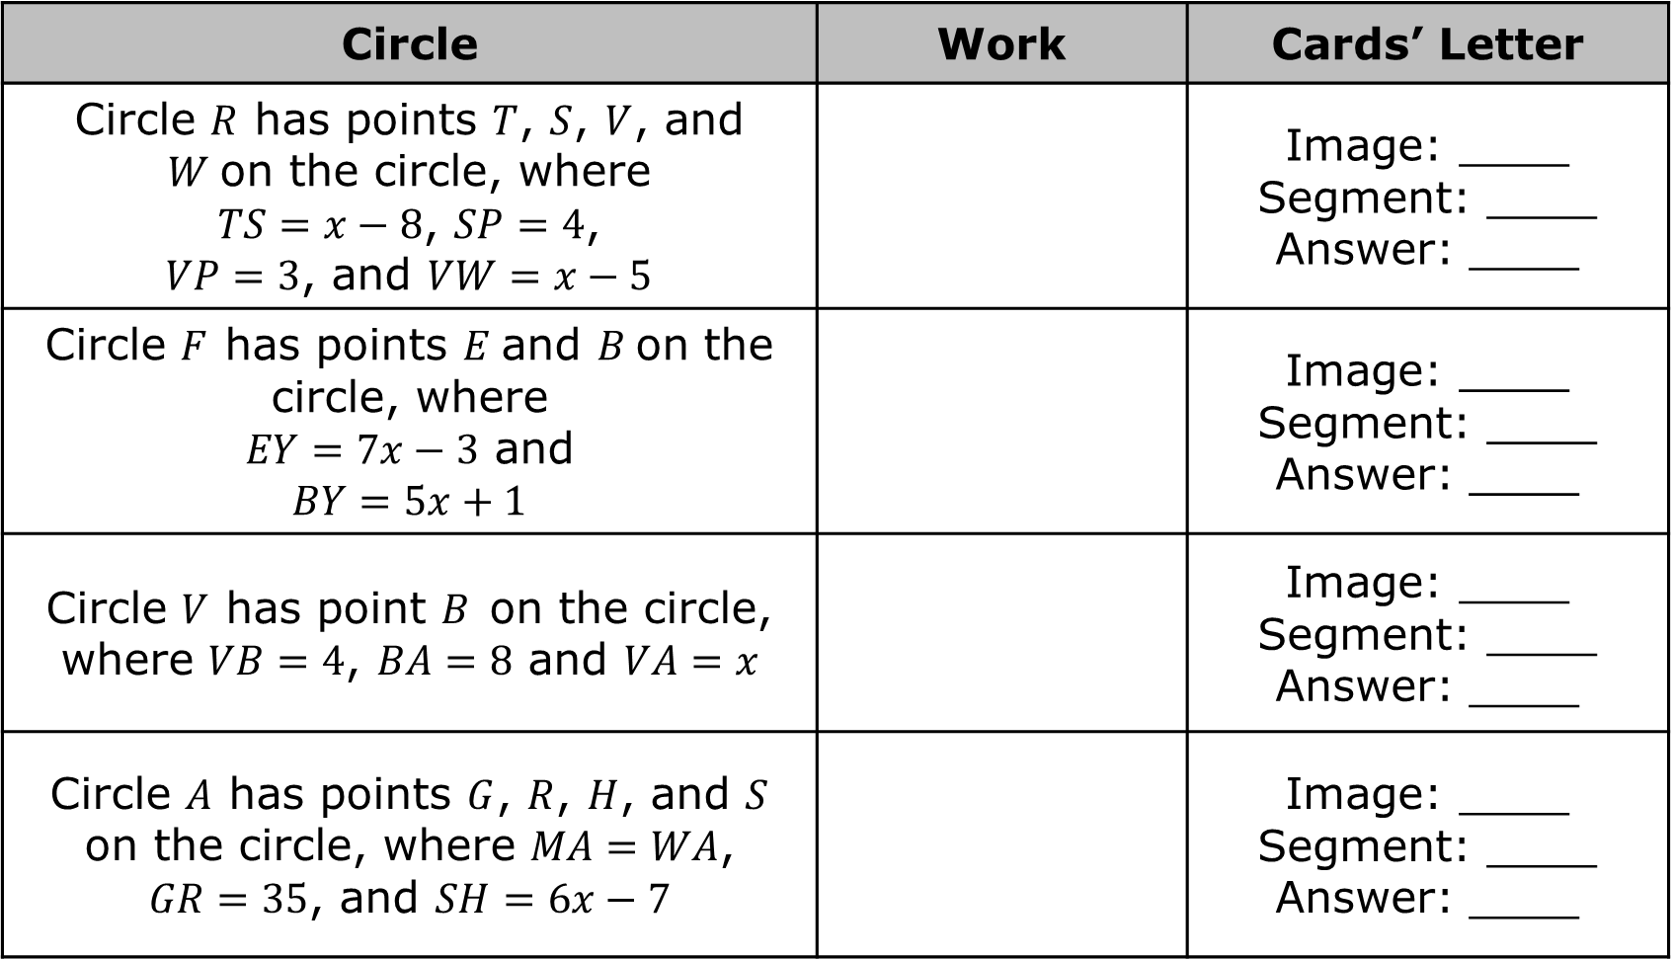
Circle | Work | Cards’ Letter
Circle $R$ has points $T$, $S$, $V$, and $W$on the circle, where $TS=x−8$, $SP=4$, $VP=3$, and $VW=x−5$ |  | Image: ____ Segment: ____ Answer: ____
Circle $F$ has points $E$and $B$on the circle, where $EY=7x−3$ and $$BY=5x+1$$ |  | Image: ____ Segment: ____ Answer: ____
Circle $V$ has point $B$on the circle, where $VB=4$, $BA=8$ and $VA=x$ |  | Image: ____ Segment: ____ Answer: ____
Circle $A$ has points $G$, $R$, $H$, and $S$ on the circle, where $MA=WA$, $GR=35$, and $SH=6x−7$ |  | Image: ____ Segment: ____ Answer: ____
volume 2, pg. 258

Slide 10

Try It
volume 2, pg. 259

Slide 11

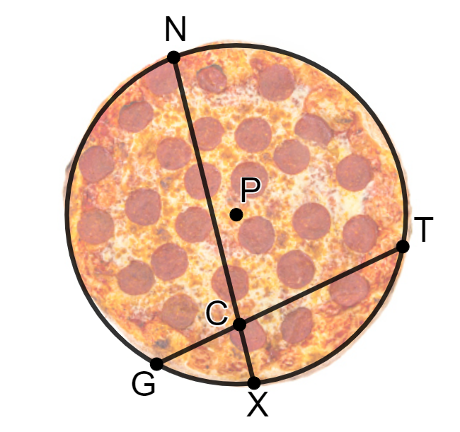
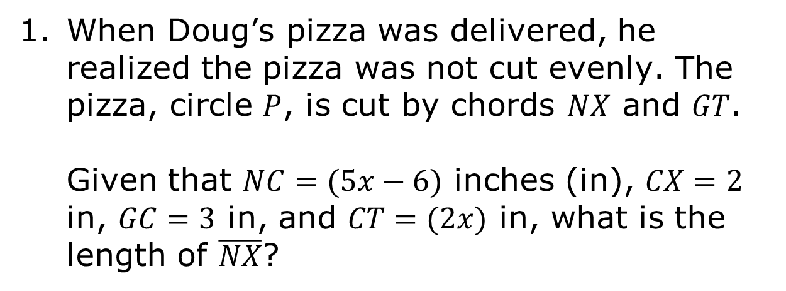
12.6.3 Try It: Solving for Length
When Doug’s pizza was delivered, he realized the pizza was not cut evenly. The pizza, circle $P$, is cut by chords $NX$ and $GT$.
Given that $NC=(5x−6)$ inches (in), $CX=2$ in, $GC=3$ in, and $CT=(2x)$ in, what is the length of $\overline{NX}$?
volume 2, pg. 259

Slide 12
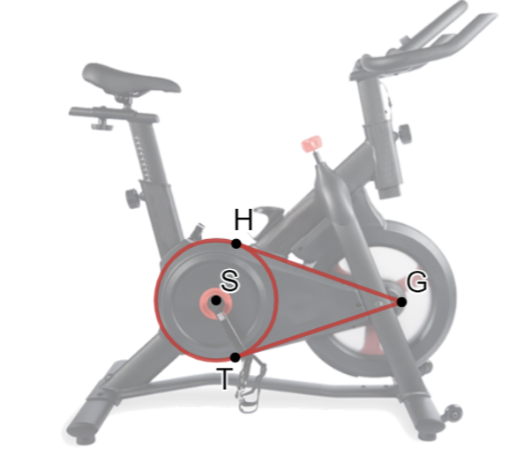
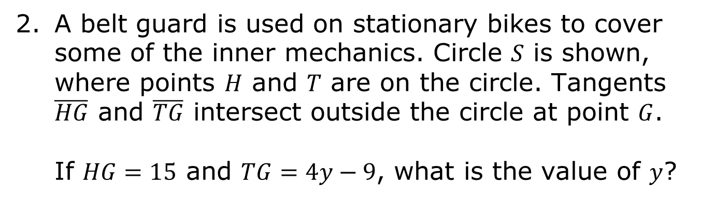
A belt guard is used on stationary bikes to cover some of the inner mechanics. Circle $S$ is shown, where points $H$ and $T$ are on the circle. Tangents $\overline{HG}$ and $\overline{TG}$ intersect outside the circle at point $G$.
If $HG=15$ and $TG=4y−9$, what is the value of $y$?
volume 2, pg. 259

Slide 13

Wrap-Up
volume 2, pg. 260

Slide 14
12.6.4 Wrap-Up: Cool Down
Write one question you still have about solving mathematical and real-world problems involving the lengths of secants, tangents, or chords of a circle.
volume 2, pg. 260

